Slide 1
Excellence. Recognition. Advancement.

Slide 2
What is the GCCC?
Notes:
First – a little background…
The Council was created by IABC as an independent and impartial body to offer certification at various levels that test against the Global Standard for Communication Professionals developed by IABC, which aims to promote a common, global understanding of what constitutes competence and excellence in the profession. The impetus to create this standard of excellence arose out of IABC’s advocacy to advance the profession by developing practitioners to become trusted strategic advisors within their organizations and to demonstrate that communication is a strategic business function critical to delivering business results.
Council members represent the communication industry worldwide and come from a broad spectrum of organizations, membership in IABC is not required to serve. The Council oversees the maintenance and renewal of the certification programs, protects their integrity, and ensures ongoing compliance with the ISO standards that have been earned for both designations (more on ISO later). The independent status of the Council underscores the importance of impartiality in carrying out its certification activities, managing conflict of interest, and ensuring the objectivity of its certification activities.

Slide 3
Why certify?

Slide 4

Based on a global standard
“Successfully testing my body of knowledge and expertise as a communications practitioner against a global standard is a meaningful and rewarding achievement. Certification also requires ongoing learning and contributions to the community of communications practitioners. I truly believe this certification will become the standard for my profession and I encourage those in the field to learn more about it.”
Ethics, Strategy, Analysis, Context, Engagement, Consistency
Glenda Power SCMP
Director of Strategic Communications, Royal Canadian Mounted Police Canada
Notes:
Getting certified demonstrates that you are competent across all six domains of the global standard and have met the GCCC’s rigorous testing requirements. For many, it is both a personal and professional achievement.

Slide 5

Designed for today’s global job market
“Being a communicator is a learning journey. Every day there's something new to pick up and to study. Communication keeps evolving and changing, and my belief is that we communicators should look to adapt and keep up with all the changes around us. This is why I believe in certification and
recertification. Given the responsibility of us and our organizations to communicate effectively, honestly, and transparently, I'd ask all my fellow professionals to keep learning every day and share their learning journey through certification and recertification.”
Alex Malouf SCMP
Corporate Communications Director, Schneider Electric United Arab Emirates
Notes:
A certification through the GCCC can increase your value and effectiveness as a strategic communication professional and the value and effectiveness of your organization because employing GCCC certification holders elevates the standard of professional communication in organizations, which leads to improved business results.
And if you manage a team of communication professionals, GCCC certification can provide a high level of confidence to senior leadership that your communication team is highly trained, meets the rigour of a global credential, and is prepared to support key business strategies and initiatives to achieve critical outcomes.

Slide 6

Make a career move, earn more, get a promotion
“Certification is one of the most valuable ways for me to reward myself and practice ‘career self-care’. It’s that stamp confirming that I’ve done the work, put in the time, and importantly, am committed to career-long learning,
exploration and growth. It motivates me to remain attuned to the latest trends in the profession, to cultivate my network
and push myself to explore areas outside of my career comforts. As the sole communicator in my company, it nourishes my need for connection – it’s tremendously satisfying to feel a part of the SCMP community and watch
our membership expand.”
Wendy Thatcher SCMP
Communications Liaison, Stoney Health Services Canada
Notes:
GCCC certificants told us they have received pay rises, been approached by recruiters, been promoted in their organizations, and received increased job offers as a result of their certification.
Research indicates:
You’re three times more likely to get shortlisted by a recruiter if you have a professional certification.
More than 50% of certified professionals are promoted within the first 6 months of getting a certification.
They’re almost twice as likely to receive regular pay rises and 6 out of 10 received a pay rise within six months of getting certified.
Those with a bachelor’s degree or higher, combined with a certification earn 18% more per week, and on average, certified professionals earn 29% more per week than their non-certified peers.
But the majority said it gave them: confidence, increased respect and recognition, and improved personal branding that led to more speaking opportunities, mentoring and influence.

Slide 7

Elevate your value
"My certification as a senior communications professional raises questions and interests and has demonstrated to clients, prospects and peers that I have a strong communications background and experience, allowing me to work with the C-level in global organizations."
Michael Nord SCMP
Principal and owner, Michael Nord Consulting The Netherlands
Notes:
Certification really is a way to stand out from the crowd – if you want to elevate your value and visibility in your organization then you should seriously consider getting certified.
It’s a seal of industry approval that you truly know your stuff and are at the top of your game.
And that’s what’s been missing from our profession – a consistent benchmark of strategic communication excellence.
And ultimately certification helps us champion our profession – by:
elevating the Global Standard as a guide and differentiator for communication professionals
enabling our certificants and customers to be advocates for our profession
building recognition with the C-suite and other professions

Slide 8
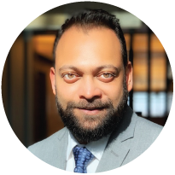
No longer good enough to just “know”
communication
“Certification in any profession is no longer a ‘nice to have’. It demonstrates your commitment to the skill and reflects your willingness to stay up to date with current standards as well as future trends. A certification is like that special ingredient in an all-time favorite recipe – reliable when you need it and always gives more than you expect.”
Arun Kayal SCMP
Associate Director, Communication, ANZ Institutional Bank
Australia
Notes:
Let’s face it, if the past few years have proved anything, it’s that it’s no longer good enough for communication professionals to just “know communication”.
Consistent standards and an ongoing focus on professional development ensures we stay relevant and is external validation that you have the communication skills needed to succeed in your communication career.

Slide 9
Offering professional development boosts employee engagement, retention and employer brand.
Identifying and closing competency gaps across teams can reduce risks and increase competitiveness.
Credentials build confidence to grow high-performing teams that deliver key business results.
Why certify your team?
Notes:
Top three reasons to certify your team…
1. Offering professional development boosts employee engagement, retention and employer brand
In the post-pandemic global race for talent, this has never been more important: Employees who have access to professional development are 15% more engaged in their jobs and those with the highest levels of commitment perform 20% better.
2. Identifying and closing competency gaps: People come into communication roles from different education backgrounds and work experience. This can result in some professional knowledge gaps that could impact effectiveness and potentially put your company at risk. Examples are missteps that could affect stock prices, brand perception, reputation and potential issues around safety.
Achieving Certification for your entire team ensures all members meet the rigour of the Global Standard of the Communication Profession – a commitment to excellence that fosters consistency and credibility throughout all communication activities.
For corporate members, the GCCC can offer a capabilities assessment for each member of the team considering certification – and make recommendations for potential skill gaps where further learning may be required.
3. According to research, the incidence of improved confidence at work is three times higher among certified professionals when compared to their non-certified peers. This is driven by a stronger work-profile with individuals who build effective relationships with senior leaders, sharing ideas, strategic recommendations and innovative approaches that deliver impact. (Source: Career Data Labs)

Slide 10
What is GCCC certification

Slide 11
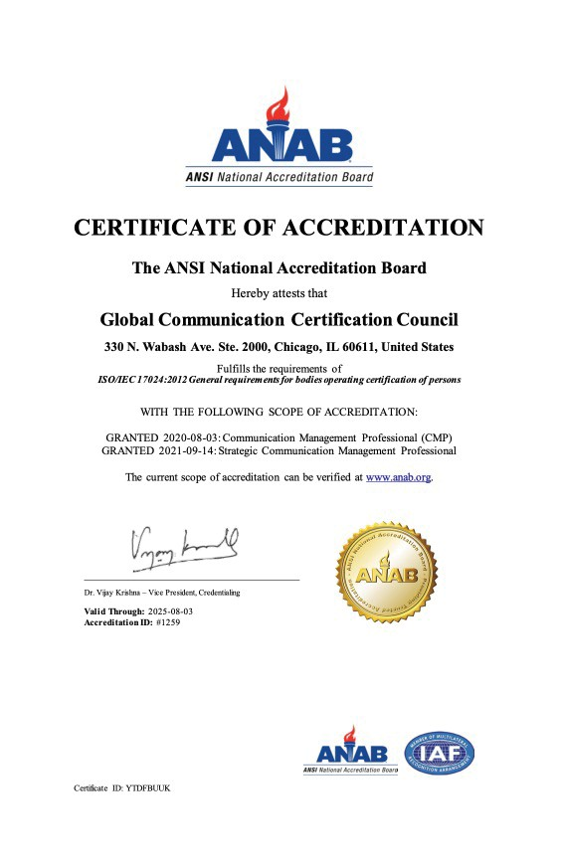
The one and only
The only communication certification program in the world that meets ISO standards (ISO/IEC 17024).
Notes:
The GCCC’s certifications are the only communication certifications in the world that meet ISO standards (ISO: The International Organization for Standardization) – which promotes worldwide standards. ISO was founded with the idea of answering one fundamental question – what is the best way of doing this? And that’s what GCCC certifications embody – the best way of certifying communication professionals against a competency framework. No other communication organisation in the world can make this claim about their certification program.
Why is this important? From a DEI perspective, ISO guarantees an equitable and repeatable process every time, everywhere in the world. Also, the multiple-choice examination is a 100% fact-based test that does not include subjective evaluations that can skew results. This is not the case with other accreditation programs that rely on human evaluators to assess responses.

Slide 12

Communication Management Professional (CMP)
established in your career as a communication professional and looking to demonstrate your competence
8 YEARS
OR
6 YEARS
OF EXPERIENCE
OF EXPERIENCE,
2 YEARS OF EDUCATION
+ 40 HOURS OF TRAINING
+ 40 HOURS OF TRAINING
What certifications are available?
Strategic Communication Management Professional (SCMP)
highly skilled and practiced in providing strategic communication advice and counselling to your organization’s leadership
+
11 YEARS
LETTER OF RECOMMENDATION FROM A MENTEE OR AN ORGANIZATION FOR WHICH YOU’VE DONE PRO BONO WORK ADDRESSING SENIOR LEVEL CONTRIBUTIONS TO COMMUNICATION
OF EXPERIENCE
+ 20 HOURS OF TRAINING

Slide 13

What counts as training?
Skill-based events offered by businesses, non-profits, industry associations, colleges, universities, trade schools, or vocational schools.
Webinars, in-service training and self-paced courses if verifiable.
Courses, workshops and training sessions offered by:
Associations or communities of practice
Employer-sponsored programs
Training companies or consultants
Distance-learning companies, including an end of course assessment
University or college academic and continuing education programs
Notes:
To note: The Council itself does not offer any skills-based training directly to prepare for examinations. This is part of maintaining impartiality and managing potential conflict of interest. IABC does, however, offer professional development that can be useful to cover knowledge gaps in particular domains. See The Career Assessment tool and the Resources page for exam prep on the GCCC website.

Slide 14


CMP EXAM
SCMP EXAM
3 HOURS
TO COMPLETE EXAM
100 MULTIPLE CHOICE
QUESTIONS
3 HOURS
TO COMPLETE EXAM
100 MULTIPLE CHOICE
QUESTIONS
Notes:
The two exams allow an equal amount time to complete 100 multiple choice questions. The three hours allows time to reflect and review before submitting final answers. Our research indicates most people complete the exam within two hours.

Slide 15
Do it your way
OR
In-person testing
Remote proctoring
Notes:
Any association, organization, or individual can host an in-person exam.

Slide 16
What you’re tested on:
CMP
Ethics
7%
SCMP
Advising & Leading
23%
Reputation Management
18%
Measurement
20%
Research & Analysis 21%
Ethics
10%
Consistency
& Strategic Implementation
16%
Innovation
10%
Strategy & Engagement 36%
Management
20%
Strategy Development
19%
Notes:
The CMP exam has five domains, the SCMP has six. Each has a comprehensive Job Task Analysis that outlines the range of knowledge you are expected to have to operate at that level.
For example, in the Strategy & Engagement domain for CMP (which accounts for 36% of the exam), there is a set of tasks that include:
Establishing measurable objectives to provide direction and deliver meaningful communication outcomes and outputs
Presenting the business need or opportunity and the strategic communication approach
Collaborating with internal and external partners
In the Advising & Leading domain for SCMP (23% of the exam) that includes tasks such as:
Counseling executives and business unit leaders about communication and its effect on business results.
Coaching executives, business unit leaders, and others within the organization on how to communicate effectively in a variety of situations and settings.
Advising executives and business leaders on the communication aspects of business plans and their effects on stakeholders.
And then there is a list of the knowledge you should possess to effectively carry out these tasks – so it’s a comprehensive guide you can use to prepare for the exam.
There are also practice tests available on the GCCC’s website to give you an idea about what kind of questions will be on the exam.

Slide 17
MEMBERSHIP TYPE
COST
CERTIFICATION RENEWAL
Group 1
Members of any Global Alliance member organization
$395 USD
(includes a $95 non-refundable application fee)
$95 USD
Non members
$495 USD
(includes a $95 non-refundable application fee)
$150 USD
Group 2
What it costs
Members of any Global Alliance member organization
$250 USD
(includes a $50 non-refundable application fee)
$50 USD
Non members
$350 USD
(includes a $50 non-refundable application fee)
$95 USD
SCMP – ABC Only Application
SCMP exam fee
$195 USD
Notes:
Note: Pricing as of January 2023. One thing we’ve worked really hard to do at the GCCC is ensure that certification is more accessible, so we’ve restructured our fees. Previously, there was one cost for IABC members and another for everyone else – regardless of location.
We’ve now grouped countries based on the World Bank's system for classifying national economies by income per capita, and a full list of countries is available on our website. In addition, all members of any Global Alliance member organization can take the exam at the same price – IABC, PRSA, CPRS, PRIA, PRINZ and many more – almost 80 member organizations.

Slide 18
Annual Maintenance
You must earn 40 continuing professional development (CPD) points per year to maintain your certification.
Complete your renewal application and pay the annual fee.
What happens once you’re certified
Notes:
Certification is not a one and done – it’s based on ongoing learning – and if we’ve learnt anything during the past few years is that the communication landscape is dynamic and changes rapidly, so we need to continue to sharpen our communication practice to stay relevant.
Examples of activities that count towards certification renewal including:
Attending and/or speaking at communication skills-based events
Reading and/or authoring content about strategic communication management
Leadership within the profession
Mentoring
Entering any communication award program where a substantiated entry needs to be made, and more
Each of those activities count towards your CPD and details are available on the GCCC website.
The GCCC will send you a reminder notice a few months before your anniversary date, and you have a 90-day grace period to gather your information and renew – which is all done online.

Slide 19
Can retake for a $100 USD fee.
Fail a second attempt, wait six months to try again.
What happens if you fail?
Notes:
Candidates who fail will be provided with a score report for each of the exam content domains (those who pass will also receive a score report). Due to issues of exam item security, the GCCC cannot provide information on the exact questions that were answered correctly or incorrectly.
Candidates who fail the exam are eligible to retake it for an exam registration fee of US$100. Candidates who fail a second attempt must wait a minimum of six months before a third and final attempt.

Slide 20
Questions?

Slide 21
Website www.gcccouncil.org
Email info@gcccouncil.org
For more information

